Slide 1

MLflow 3.x: Unified Platform for ML & GenAI Lifecycle
“From Traditional Machine Learning to LLMs, Agents, and Prompt Engineering”

Slide 2

Challenges of ML/AI Things
MLflow has evolved significantly beyond classic ML
MLflow 3.x introduces:
  - GenAI / LLM support
  - Prompt Registry
  - Tracing & Observability
  - GenAI Evaluation & Quality Monitoring
  - Unified Model + Prompt + Dataset lifecycle
Time to modernize our understanding & workflows
MLflow now solves problems for both ML engineers and GenAI app builders
Developing machine learning applications is much more than just finding accuracy and is a more complex task than it seems.
Prod ready ML App
Finding Accuracy
Image: https://www.synergita.com/blog/okr-management-software/difference-between-a-challenging-objective-and-unattainable-one/

Slide 3

ML/AI Development Challenges (Classic + GenAI)
I have been creating monster models on my own computer, but what was I doing 2 months ago?
Prompt drift, hard to evaluate LLM quality
It’s difficult to keep track of experiments.
Image: https://seanwes.com/podcast/399-finding-time-and-energy/
Notes:
Hard to track experiments, runs, versions
Hard to reproduce models (environments, code, data)
No standard for packaging & deploying ML or GenAI apps
For GenAI:
Prompt drift
Model output variability
Hard to evaluate LLM quality
Lack of traceability inside multi-step agent workflows

Slide 4

Challenges of ML Things
Man, this code was working perfectly before. Why isn't it working now?
I wonder which packages was installed back then?
Which Python version was it?
It’s difficult to reproduce code
Görsel: http://www.lawfulrebel.com/thinking-important/

Slide 5

Challenges of ML Things
Everyone has their own way of eating yogurt
There’s no standard way to package and deploy models.
Image: https://lyriquediscorde.com/2012/09/27/the-70s-you-can-go-your-own-way/

Slide 6
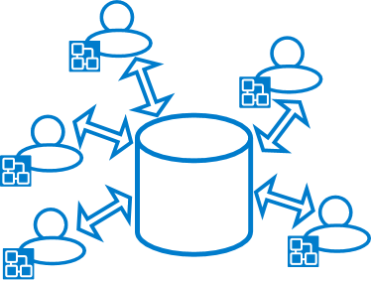
Challenges of ML Things
So many data scientist build hundreds models so far.
Who know where are they?
There’s no central store to manage models
(their versions and stage transitions)
Image: https://lyriquediscorde.com/2012/09/27/the-70s-you-can-go-your-own-way/

Slide 7
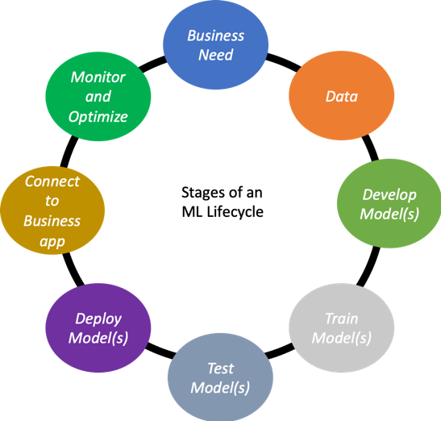
Challenges of ML Things
You have to keep the cycle turning constantly.
The more automated, the better
Image: https://cdn.app.compendium.com/uploads/user/e7c690e8-6ff9-102a-ac6d-e4aebca50425/5ff89cbc-ea1e-4ab0-b646-877369cad553/File/db1143146969d1d08c338d1fba5a2f8b/stages_of_machine_learning_lifecycle.png

Slide 8
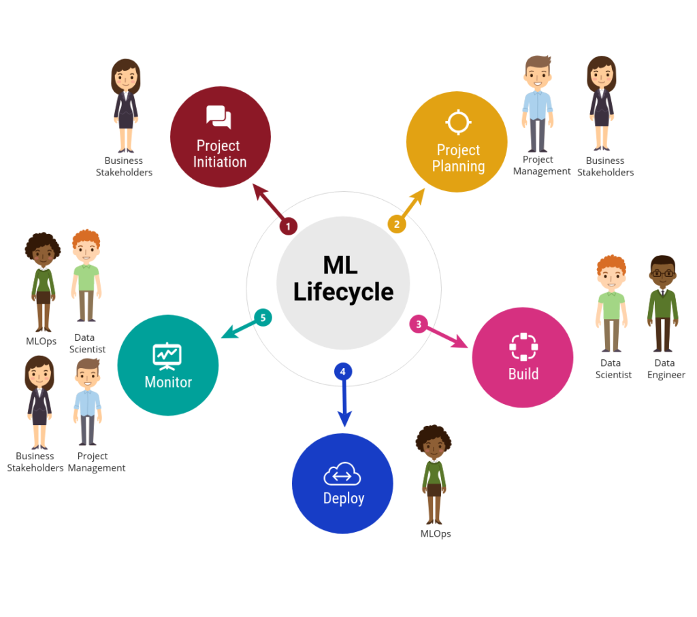
Challenges of ML Things
What was this model made for?
What was the problem it was solving?
Who made it and when?
What were the hyperparameters?
What were the codes?
What was the performance metric?
Is there an explanation or any details about it?
A lineage is a must for every model
Image: https://medium.com/ai-in-plain-english/ai-biggest-struggle-yet-no-streamlined-mlops-as-a-service-a4e4b42422ae

Slide 9
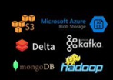



Challenges of ML Things
Did we build this model with Spark?
Were we supposed to deploy in Java?
Were we going to predict from mobile app?
No tool and framework alone can handle all lifecycle
Image: https://medium.com/ai-in-plain-english/ai-biggest-struggle-yet-no-streamlined-mlops-as-a-service-a4e4b42422ae

Slide 10
MLflow Overview
Stepping into the world of Machine Learning (ML) is an exciting journey, but it often comes with complexities that can hinder innovation and experimentation.
MLflow is a solution to many of these issues in this dynamic landscape, offering tools and simplifying processes to streamline the ML lifecycle and foster collaboration among ML practitioners.

Slide 11
MLflow Overview
MLflow provides a unified platform to navigate the intricate maze of;
  Model development
  Deployment
  Management
MLflow aims to enable innovation in ML solution development by streamlining otherwise cumbersome logging, organization, and lineage concerns that are unique to model development.

Slide 12
MLflow Core Components
Tracking
Artifacts & Metadata Store
Model Registry
Prompt Registry (NEW)
MLflow Deployments & AI Gateway
Evaluations (ML + GenAI)
Tracing & Observability (NEW)
Recipes & Projects
UI (improved for datasets, evaluations, traces)

Slide 13
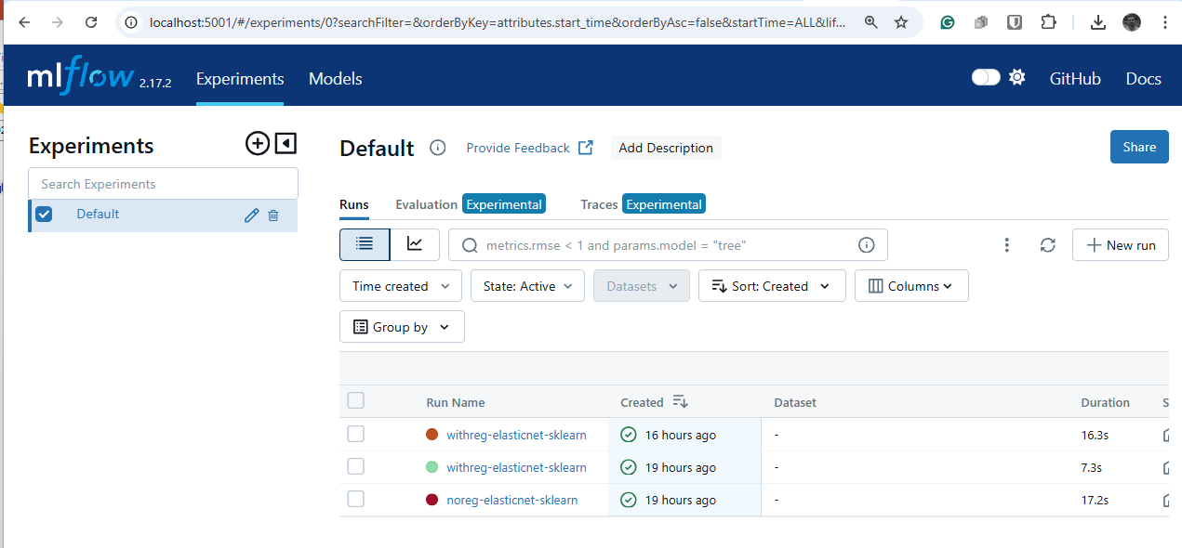
1. Tracking
Provides API and UI
During the ML/AI process logs
  Parameters
  Code versions
  Metrics
  Artifacts
  Log parameters,
  Log prompts,
  LLM responses,
  Evaluation results,
  Auto logging
  supports GenAI runs via mlflow.genai

Slide 14


1. MLflow Tracking Storage
  During the model training logs are sent ML_FLOW_TRACKING_URI defined tracking server.
ML_FLOW_TRACKING Server
mlflow server \
--backend-store-uri /mnt/persistent-disk \
--default-artifact-root s3://my-mlflow-bucket/ \
--host 0.0.0.0
Artifact Store
Amazon S3
Azure Blob Storage
Google Cloud Storage
FTP server, SFTP Server
NFS, HDFS
Entity (Metadata) Store
FileStore (local file system),
SQLStore (SQLAlchemy ile),
REST Store

Slide 15


1. MLflow Tracking Our Architecture
ML_FLOW_TRACKING Server
Entity (Metadata) Store
Artifact Store

Slide 16
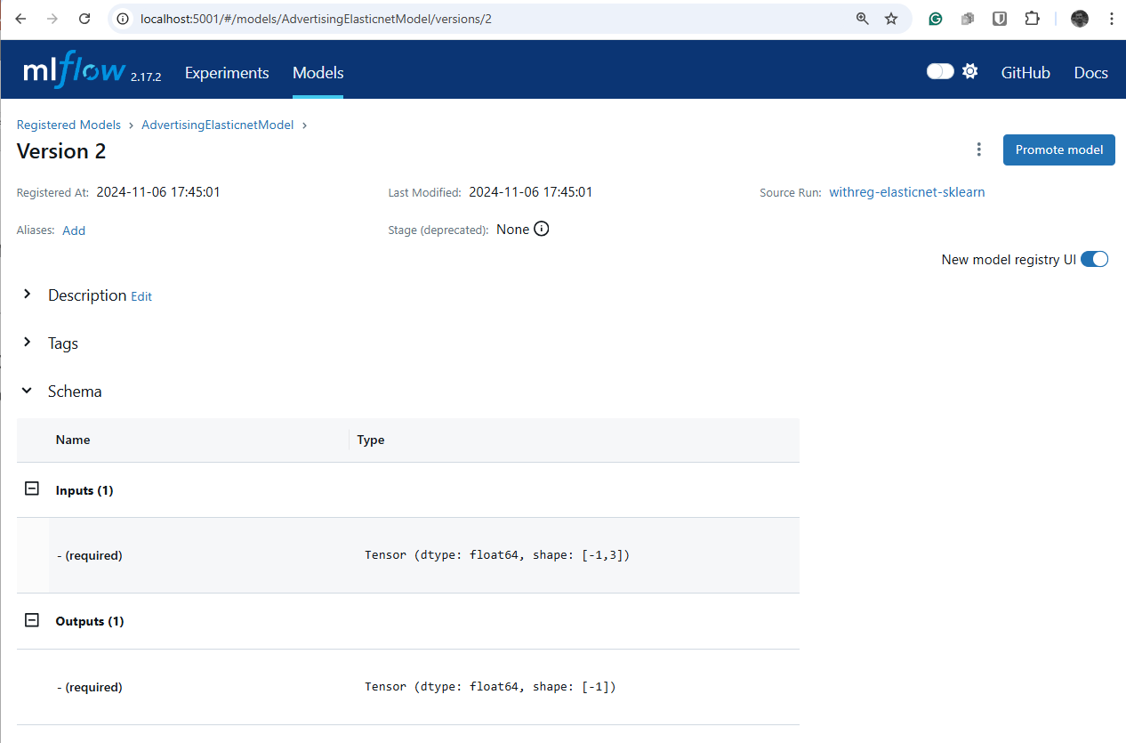
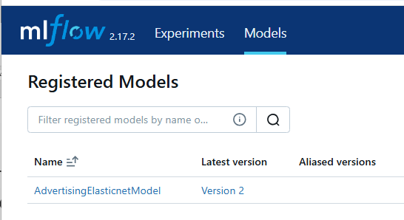
2. Model and Prompt Registry
A systematic approach to model management, the Model Registry assists in handling different versions of models, discerning their current state, and ensuring smooth productionization.
It offers a centralized model store, APIs, and UI to collaboratively manage an MLflow Model’s full lifecycle, including model lineage, versioning, aliasing, tagging, and annotations.
Version, compare, alias prompts
Prevent prompt drift

Slide 17
3. Tracing
LLM calls
Tool calls
Agent workflows
Nested traces

Slide 18
4. Evaluation
mlflow.evaluate()
LLM judges
Per-row evaluation

Slide 19
5. MLflow Deployments for LLMs and AI Gateway
This server, equipped with a set of standardized APIs, streamlines access to both SaaS and OSS LLM models.
It serves as a unified interface, bolstering security through authenticated access, and offers a common set of APIs for prominent LLMs.
A major advantage of using the MLflow AI Gateway is its centralized management of API keys.
MLflow AI Gateway (Experimental)

Slide 20
6. Evaluate
After building and training your MLflow Model, you can use the mlflow.evaluate() API to evaluate its performance on one or more datasets of your choosing.
mlflow.evaluate() currently supports evaluation of MLflow Models with the python_function (pyfunc) model flavor for classification, regression, and numerous language modeling tasks (see Evaluating with LLMs), computing a variety of task-specific performance metrics, model performance plots, and model explanations.
Evaluation results are logged to MLflow Tracking.

